Slide 3
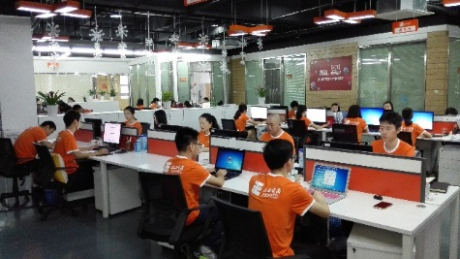
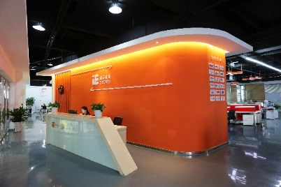
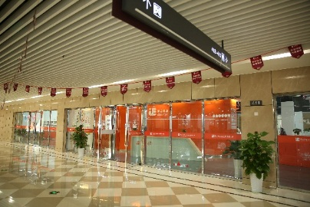
Founded Time:Founded on 24th Jan 2013 .
Main Business:Cross-border E-commerce Business & Importing trade.
Staff:Over 120Employees
Main Philosophy : “Leading the fashion, Holding together,Focusing on service, Winning the global market, Enjoying the life”.
Main Responsibility : “Sourcing the best products to create quality life for the consumers”.

Slide 5
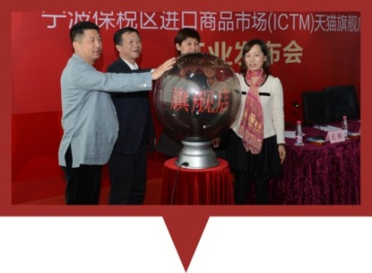
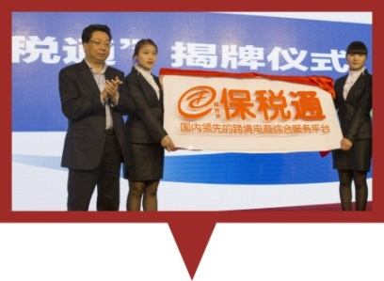
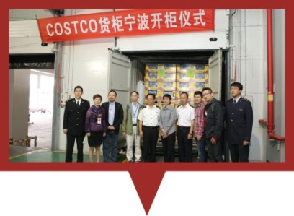
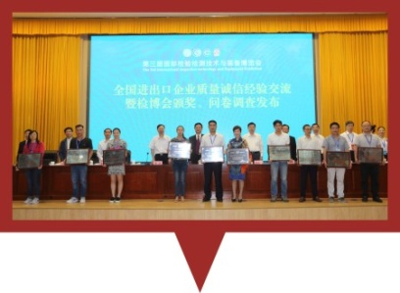
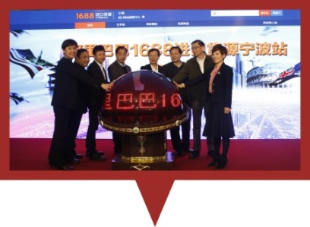
ICTM Tmall Flagship Store
Bao Shui Tong
COSTCO
China Quality Credit
Enterprise
In.1688.com Ningbo Station

Slide 8
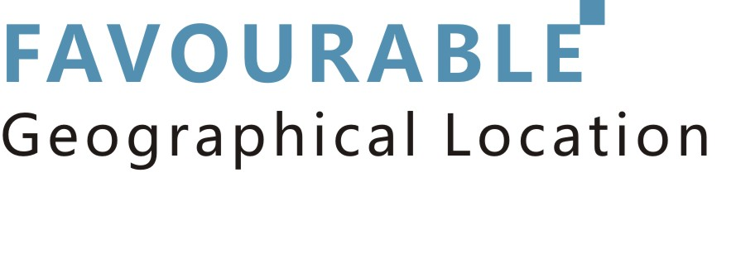
Shipping by Sea: Ningbo Port
Shipping by Air: Shanghai Pudong International Airport

Slide 9
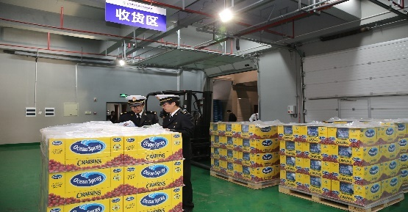
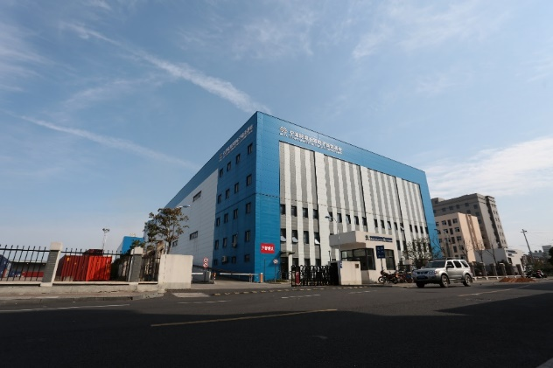
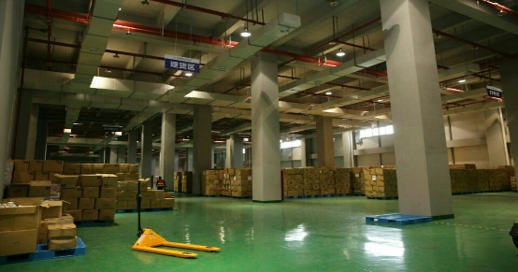
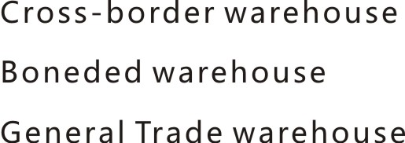
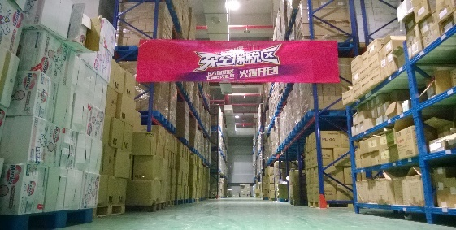
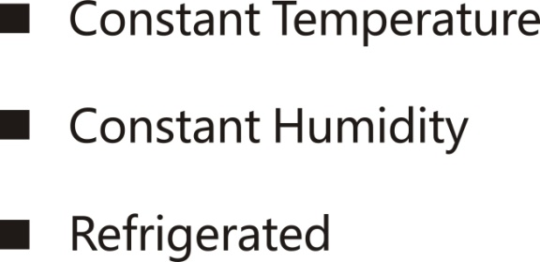
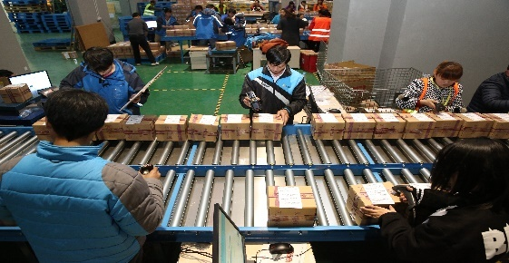
Receiving Area
Tally Area
High Racks
Delivery Area

Slide 10
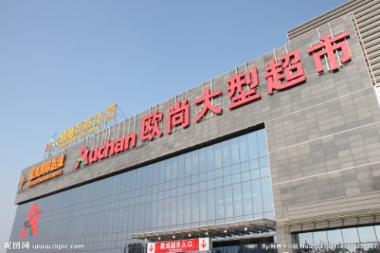
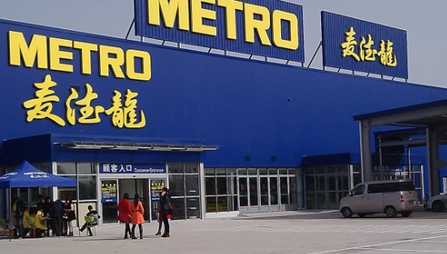
Ningbo Station

Slide 11
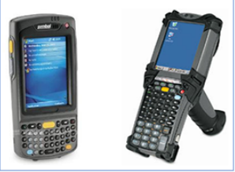
GTS
WMS
PDA

Slide 12
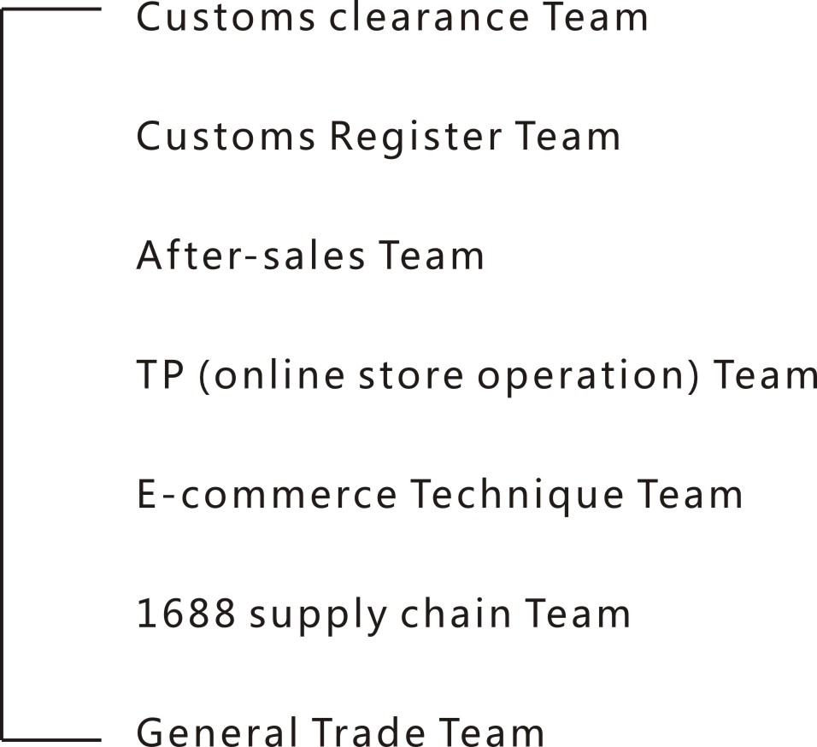
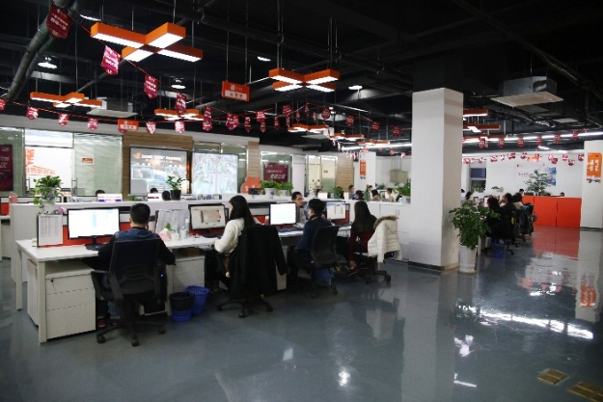

Slide 14
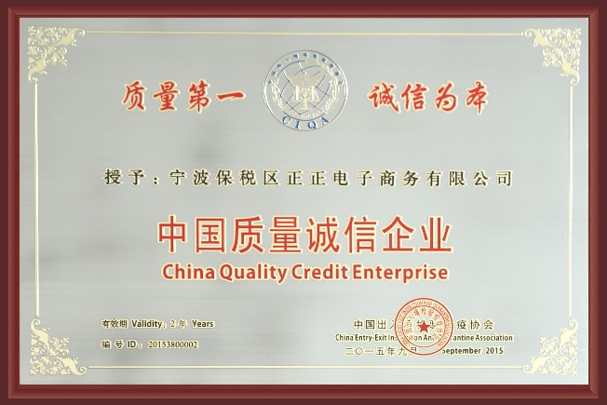
China Quality Credit Enterprise
Service Innovation of Cross-border E-commerce Enterprise
E-commerce Practice Base In Zhejiang Province
Innovation demonstration in Internet Enterprise

Slide 15
合作平台（国内主流一线平台）
Cooperated Platforms

